Slide 1
ROUTE OPTIMISING ROBOT
Domain of Mini Project : Robotics.

Slide 2
Introduction:
Autonomous system
Provide on demand services
Transport
Food delivery
Package delivery
Ability to detect obstacles
Optimizes its own route

Slide 3
2. Proposed work:
System should receives coordinate from user
Calibrate the path
Follow the path by avoiding obstacles
Reduce error in its path

Slide 4

Architecture
Pi camera
Raspberry pi
Motor driver
DC motor
Figure 1. Obstacle Avoiding Block Diagram

Slide 5
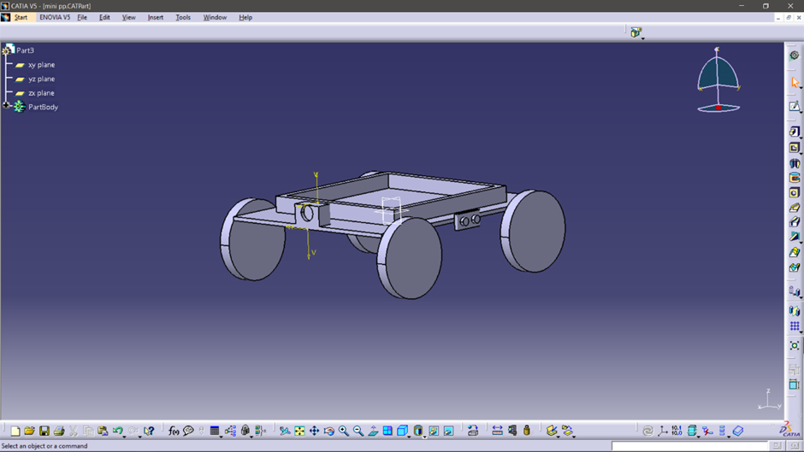
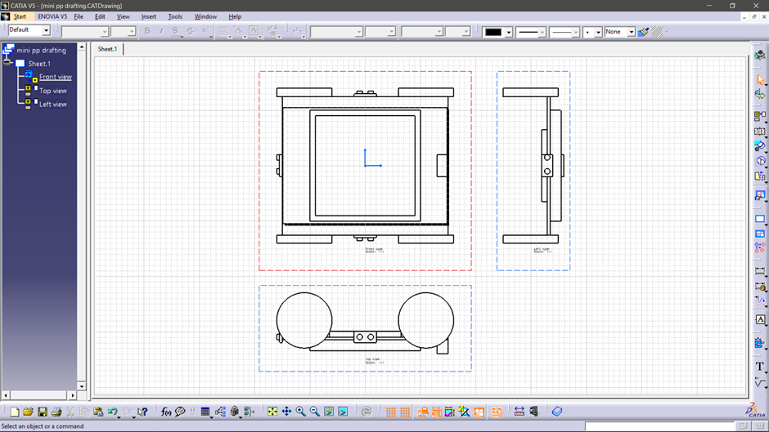

Slide 6
FLOW CHART
START
INPUT (Pi CAMERA)
IMAGE PROCESSING (Pi)
OBJECT DETECT
YFALSE
FOLLOW SAME PATH
TTTRUE
CCHANGE PATH

Slide 7
4. Expected Outcomes:-
Level 0: Obstacle avoidance
Level 1: Path planning
Level 2: Path Following with Mapping
Level 3: Fully functional algorithm with a working Demo

Slide 8
Obstacle avoiding
By using Open source computer vision is a library of programming functions mainly aimed at real time vision.
Computer vision, which can be used for image processing,
detection, face recognition, object identification.
In our project it is used to detect the obstacle and guide the robot
on obstacle free path.

Slide 9
Path planning
It can compute an obstacle free path between two locations on a given map using the Probabilistic Roadmap (PRM) path planner.
By using MATLAB we represent map as an occupancy grid map using imported data. PRM uses this binary occupancy grid representation to deduce free space.
Define start and end locations on the map for the PRM path planner to find an obstacle free path.

Slide 10
Path planning (flow chart)
Define Robot Dimensions and Inflate the Map
Construct PRM and Set Parameters
Find a Feasible Path on the Constructed PRM

Slide 11
Detail Budget Estimation

Slide 12
Reference
• Kristof Goris, “Autonomous Mobile Robot Mechanical Design”,Vrijie Universites Brussel,2004-2005
• Gurjashan Singh Pannu, Mohammad Dawud Ansari, Pritha Gupta. “Design and Implementation of Autonomous Car using Raspberry Pi”, International Journal of Computer Applications, March 2015.

